Slide 1
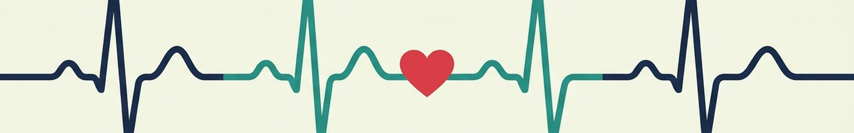
BYRCHALL HIGH SCHOOL
Becoming a Doctor:
Could It Be You?
with Dr Nayyar Naqvi OBE
Emeritus Consultant Cardiologist

Slide 2
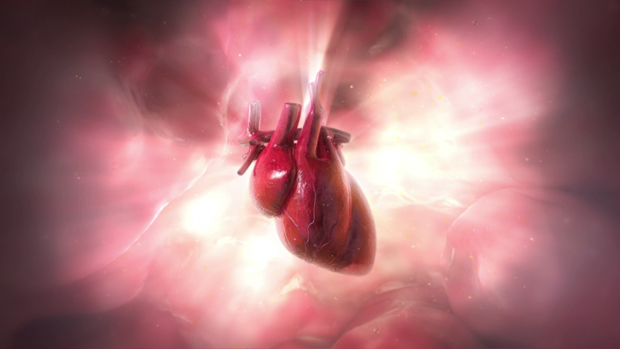
The heart
It never takes a break, even while you sleep.

Slide 3
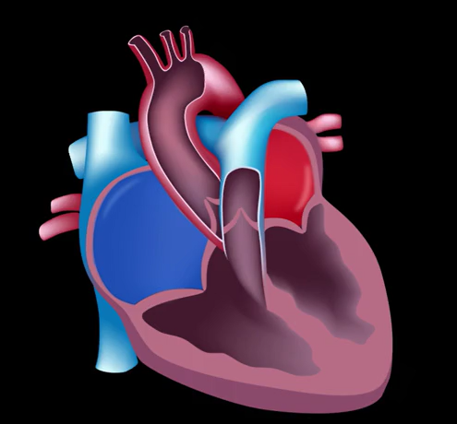
Naqvi’s Rule of 4
An easy way to remember how the heart is built.
4
chambers
4
valves
4
big tubes

Slide 4
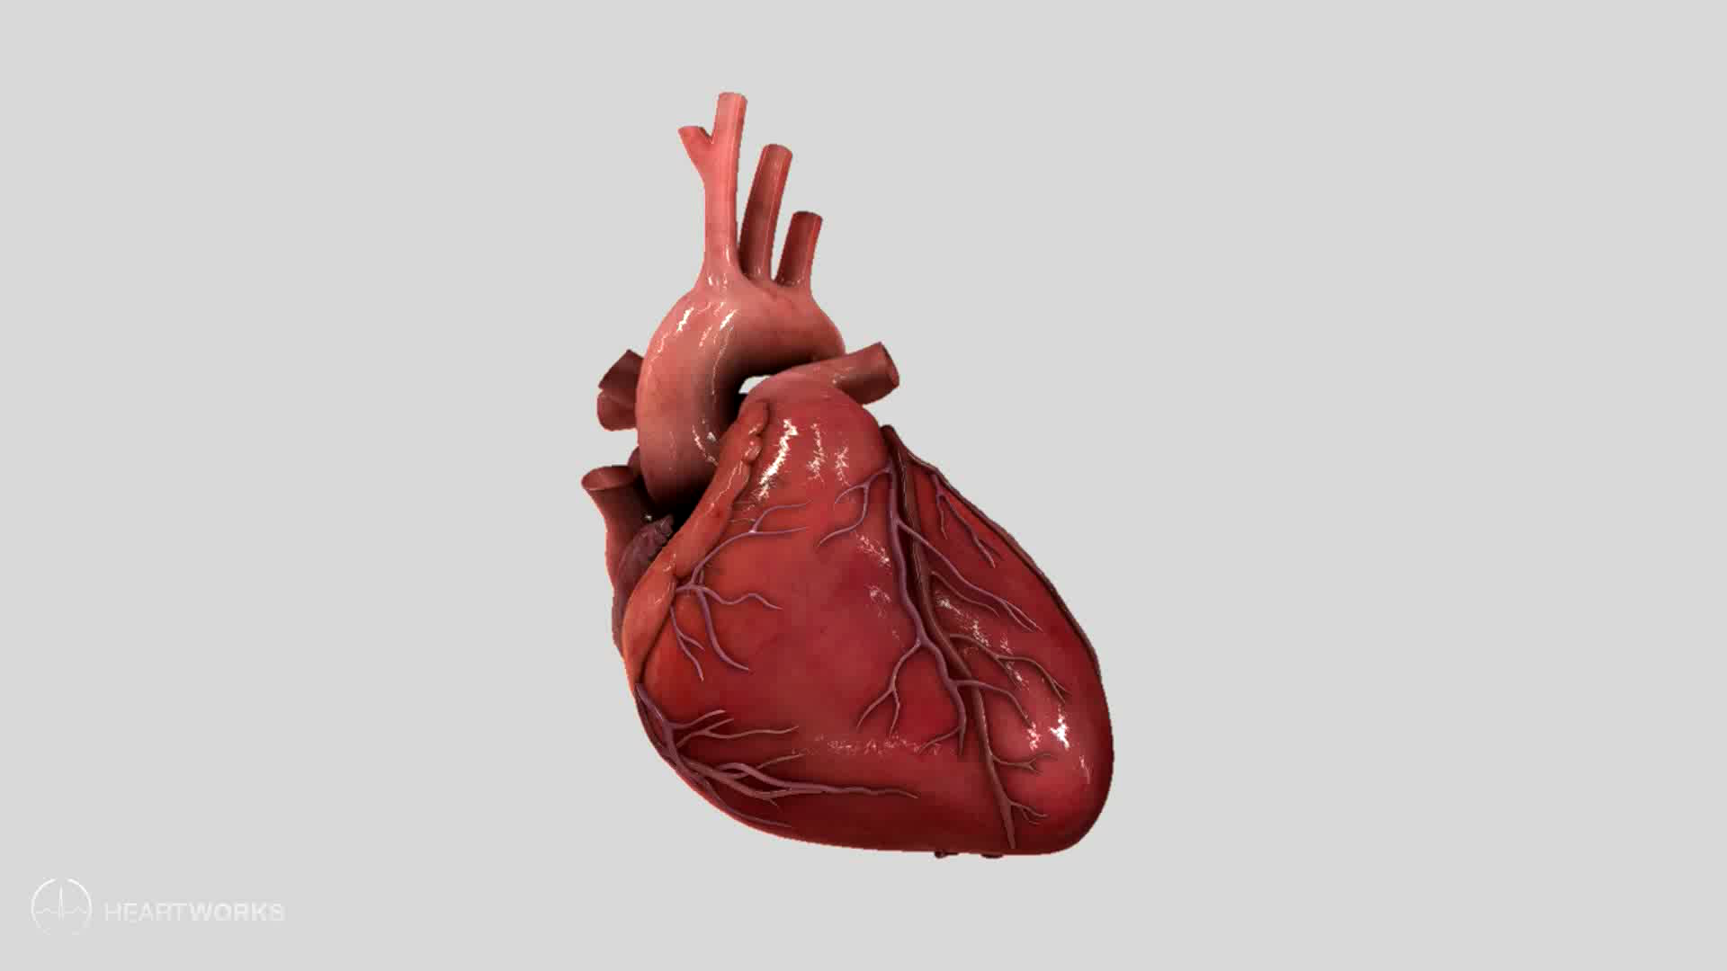
The heart from the outside

Slide 5
Find your own pulse
Every beat you feel is your heart pumping blood.
Hold one hand out, palm up.
Beats in 30 seconds
1
× 2
Put two fingers of your other hand on your wrist, just below your thumb.
2
= beats per minute
Press gently and count the beats for 30 seconds.
3
30-second timer
Use your fingers, not your thumb – your thumb has its own pulse.

Slide 6
Roughly how many times does a healthy heart beat each minute when you are resting?
A
10 - 20
B
30 - 50
C
60 - 100
D
150 - 200

Slide 7
An ECG: the heart's electricity
Sticky pads on the skin pick up the signal that makes each heartbeat.
Normal heartbeat: about 70 beats a minute

Slide 8
If you ran on the spot now and counted your pulse again, would your number go up or down?

Slide 9
Physician or surgeon?
Physician
Treats illness with medicines, tests and procedures
Surgeon
Treats illness by carrying out operations

Slide 10

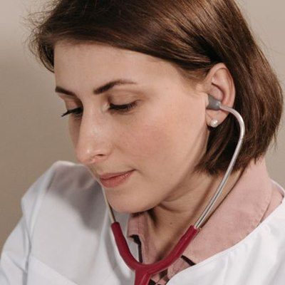
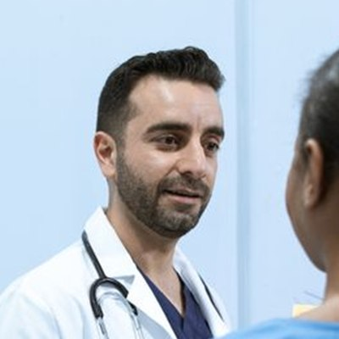
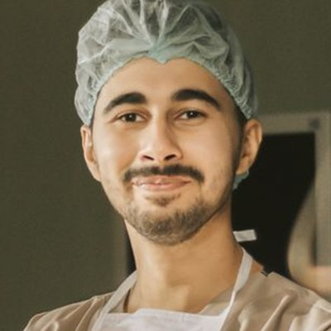
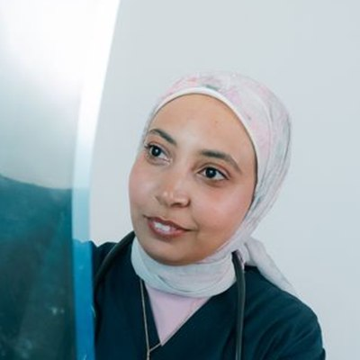
Meet some doctors
GP treats a wide range of health problems and is often the first doctor you see
Paediatrician specialises in treating babies, children and young people
Emergency doctor treats people who are suddenly very ill or badly injured
Surgeon treats some illnesses and injuries by carrying out operations
Radiologist uses X-rays, CT and MRI scans to help work out what is wrong

Slide 11
Meet some doctors
CASE 1 | WHO SHOULD SEE THEM?
A 7-year-old has been unwell for several weeks. They have lost weight, are extremely tired and their GP thinks they need to see a doctor who specialises in children.
A
B
C
D
E
GP
Paediatrician
Emergency doctor
Surgeon
Radiologist
Often the first doctor you see; treats lots of problems
Treats babies, children and young people
Treats people suddenly very ill or badly injured
Treats some problems by doing operations
Uses X-rays and scans to find what is wrong

Slide 12
Meet some doctors
CASE 2 | WHO SHOULD SEE THEM?
A 27-year-old arrives at hospital after falling from a bike. They are confused, have been sick and may have injured their head. Who would probably see them first?
A
B
C
D
E
GP
Paediatrician
Emergency doctor
Surgeon
Radiologist
Often the first doctor you see; treats lots of problems
Treats babies, children and young people
Treats people suddenly very ill or badly injured
Treats some problems by doing operations
Uses X-rays and scans to find what is wrong

Slide 13
Meet some doctors
CASE 3 | WHO SHOULD SEE THEM?
A patient has severe stomach pain. Tests show that their appendix needs to be removed.
A
B
C
D
E
GP
Paediatrician
Emergency doctor
Surgeon
Radiologist
Often the first doctor you see; treats lots of problems
Treats babies, children and young people
Treats people suddenly very ill or badly injured
Treats some problems by doing operations
Uses X-rays and scans to find what is wrong

Slide 14
Meet some doctors
HISTORY QUESTION
What job did surgeons originally develop from?
A
B
C
D
E
Blacksmiths
Barbers
Tailors
Butchers
Bakers

Slide 15



Slide 16
Now for a more complicated case…
A 13-year-old has been hit by a car…
A
B
C
D
E
GP
Paediatrician
Emergency doctor
Surgeon
Radiologist

Slide 17
And yes – pay and hours
New (resident) doctor
Consultant or GP
£41,000 +
£76,000 – £114,000

Slide 18
How many different careers are there in the NHS?

Slide 19
From Byrchall to Medical School
School value: Aspiration
Byrchall
College
Apply
Medical school
GCSEs: aim for 7+
Chemistry + biology A levels
UCAT test + interview
5 years, then training
›
›
›
Year 12: apply for access schemes – some can lower the grades you need

Slide 20
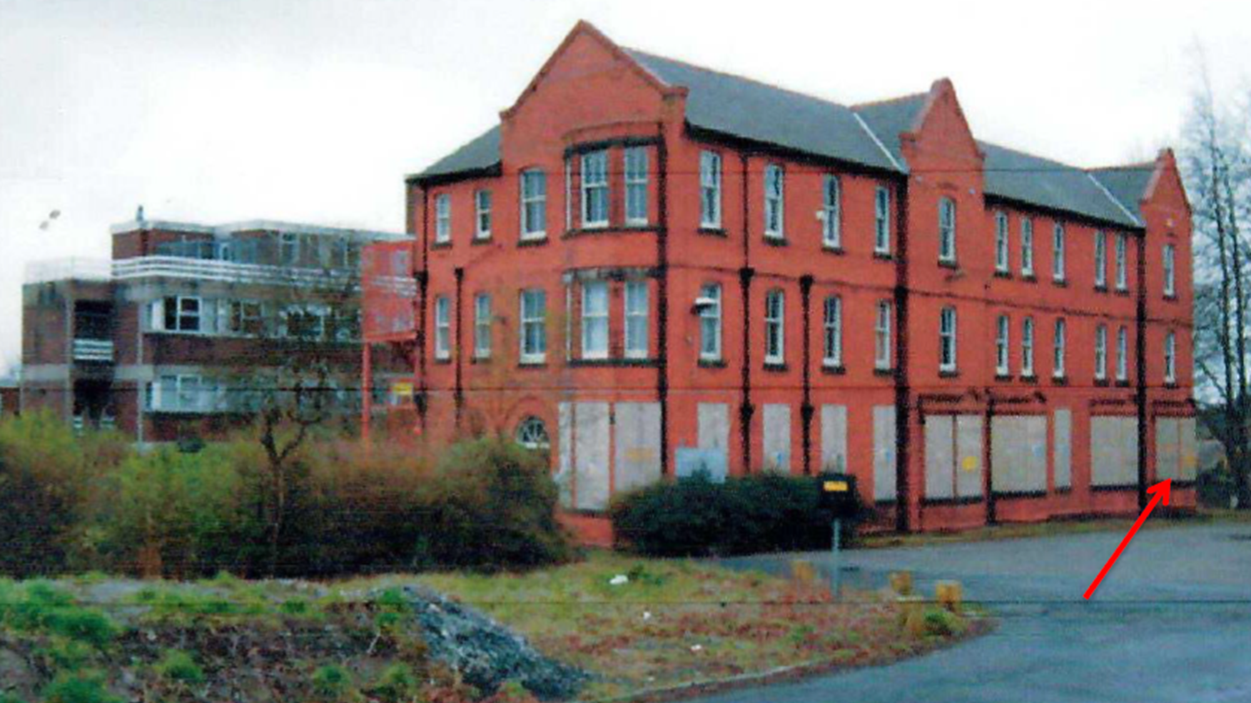
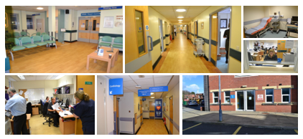

Slide 21
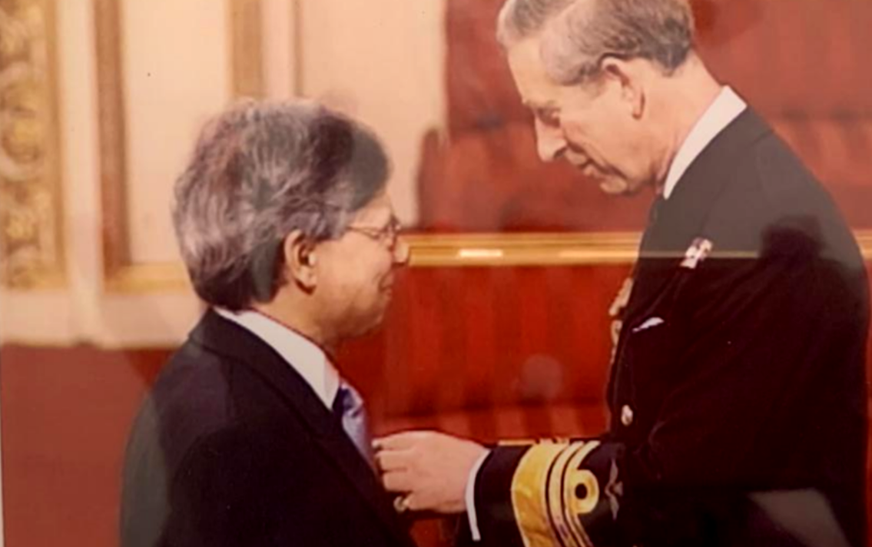
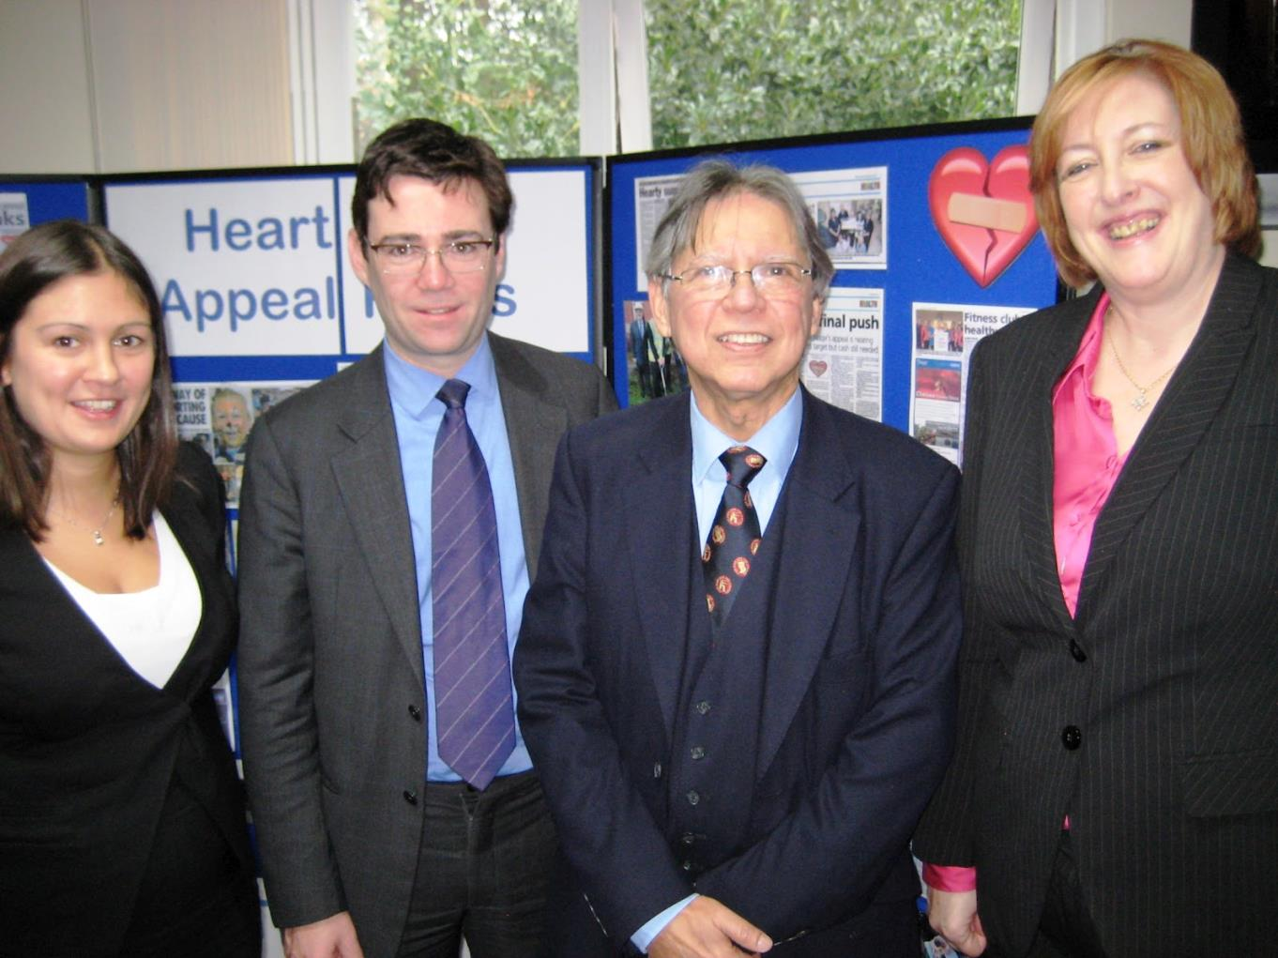

Slide 22
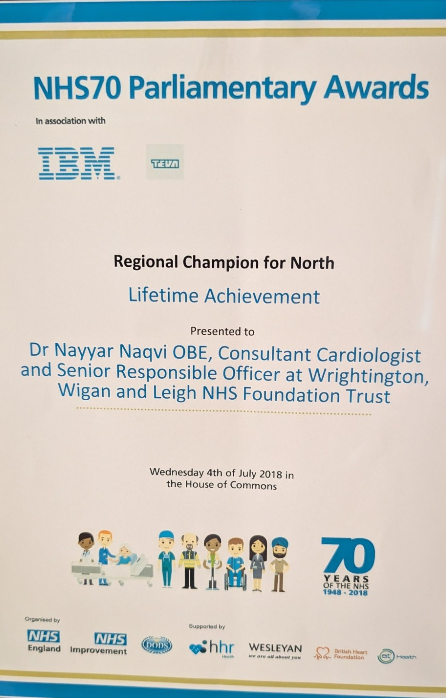
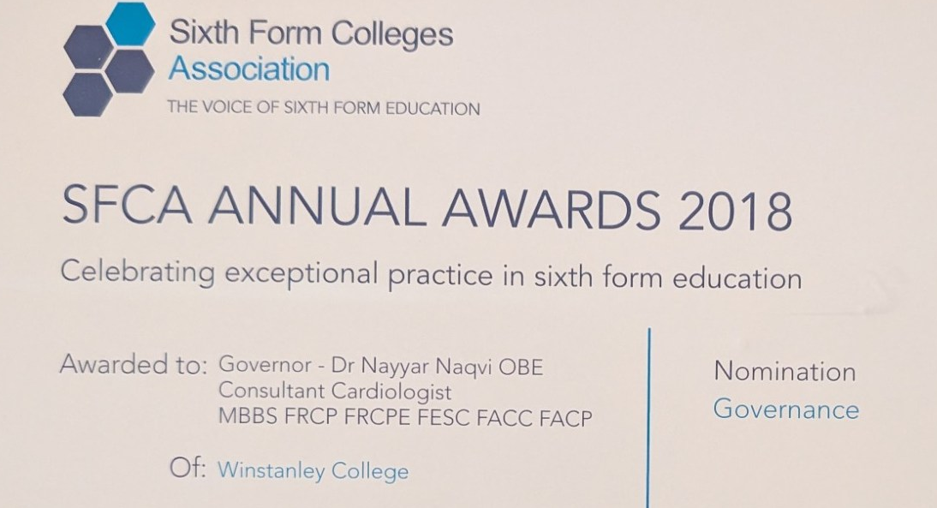
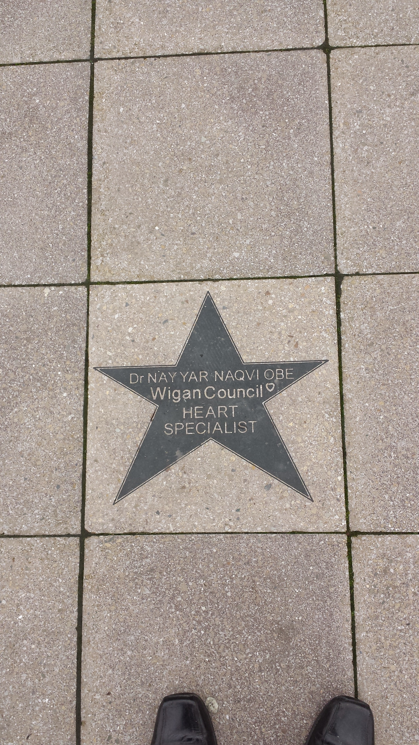
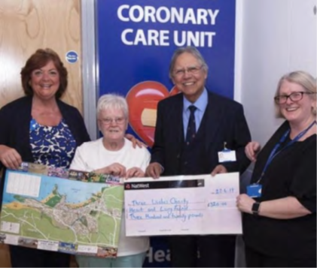
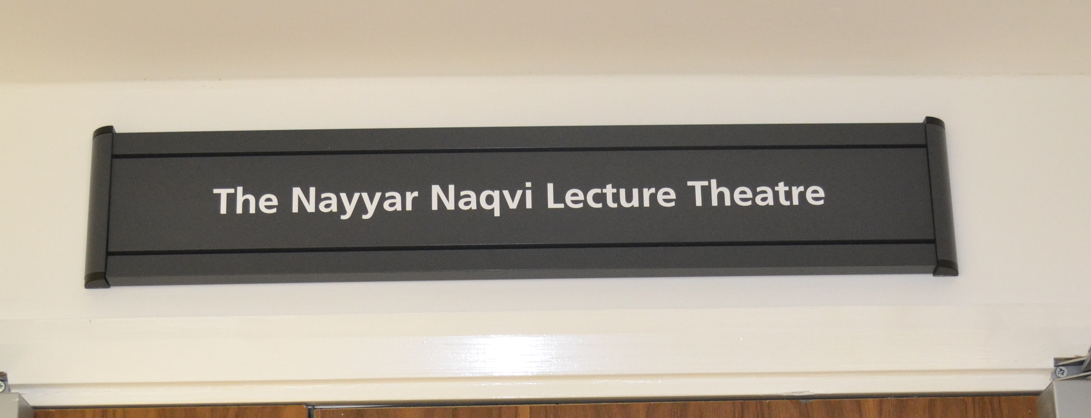

Slide 23
Why not you?

Slide 25
TRUE OR FALSE?
1 of 6
Your heart stops beating when you sneeze.
A
TRUE
B
FALSE

Slide 26
TRUE OR FALSE?
2 of 6
Your heart has its own electrical system.
A
TRUE
B
FALSE

Slide 27
TRUE OR FALSE?
3 of 6
A heart attack and a cardiac arrest are the same thing.
A
TRUE
B
FALSE

Slide 28
TRUE OR FALSE?
4 of 6
You can live with only one lung.
A
TRUE
B
FALSE

Slide 29
TRUE OR FALSE?
5 of 6
Doctors continue studying and learning after they qualify.
A
TRUE
B
FALSE

Slide 30
TRUE OR FALSE?
6 of 6
All doctors who work in hospitals perform operations.
A
TRUE
B
FALSE

Slide 31
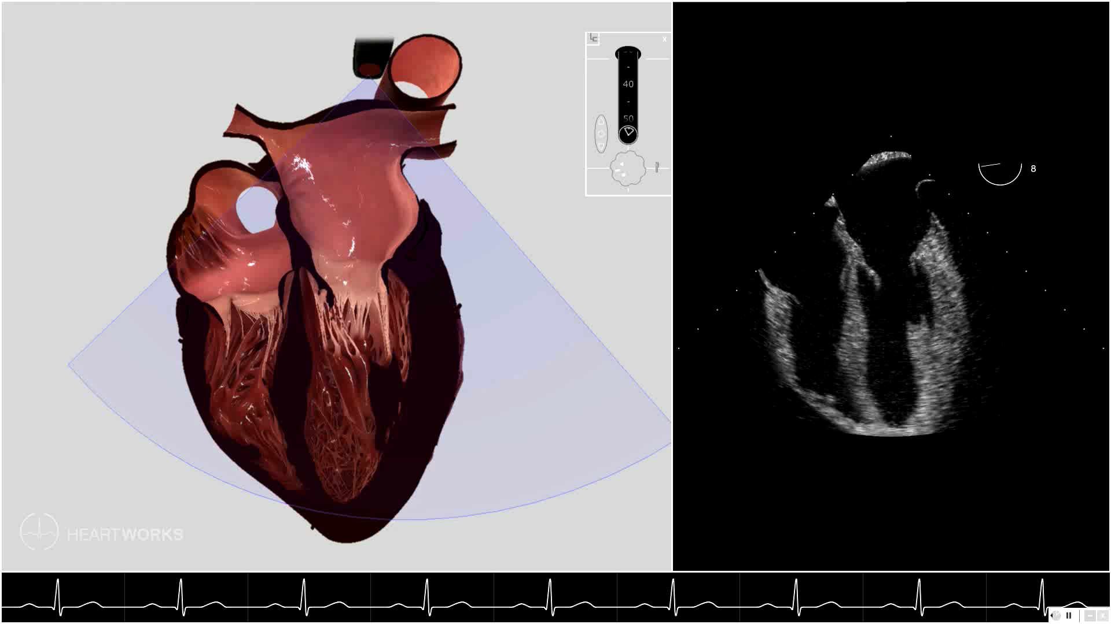
Echocardiogram
An ultrasound scan that lets doctors watch the heart beating.
Where the scan cuts through the heart
What the doctor sees

Slide 32
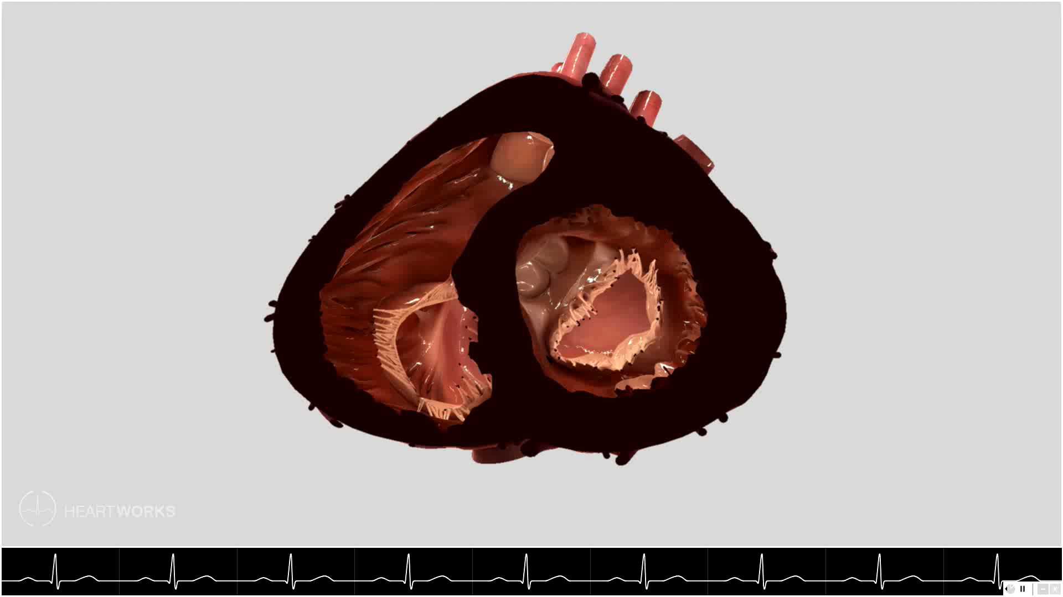
A slice through the heart
Cut across the two pumping chambers, the ventricles.
The round chamber pumps blood to the whole body.
The crescent-shaped chamber pumps blood to the lungs.

